Slide 1
Billede brugt WIN_20190131_11_16_05_Pro

Slide 2
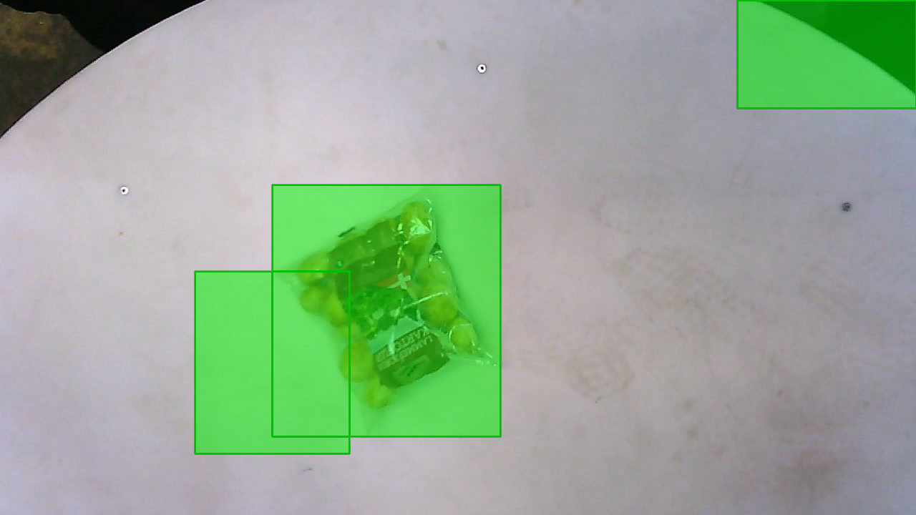
Classification loss
Bounding box
regression loss
Classification loss
Bounding box
regression loss
CNN
Classification loss
Bounding box
regression loss
CNN
Resized
RoIs
CNN
RoIs
Input image

Slide 3
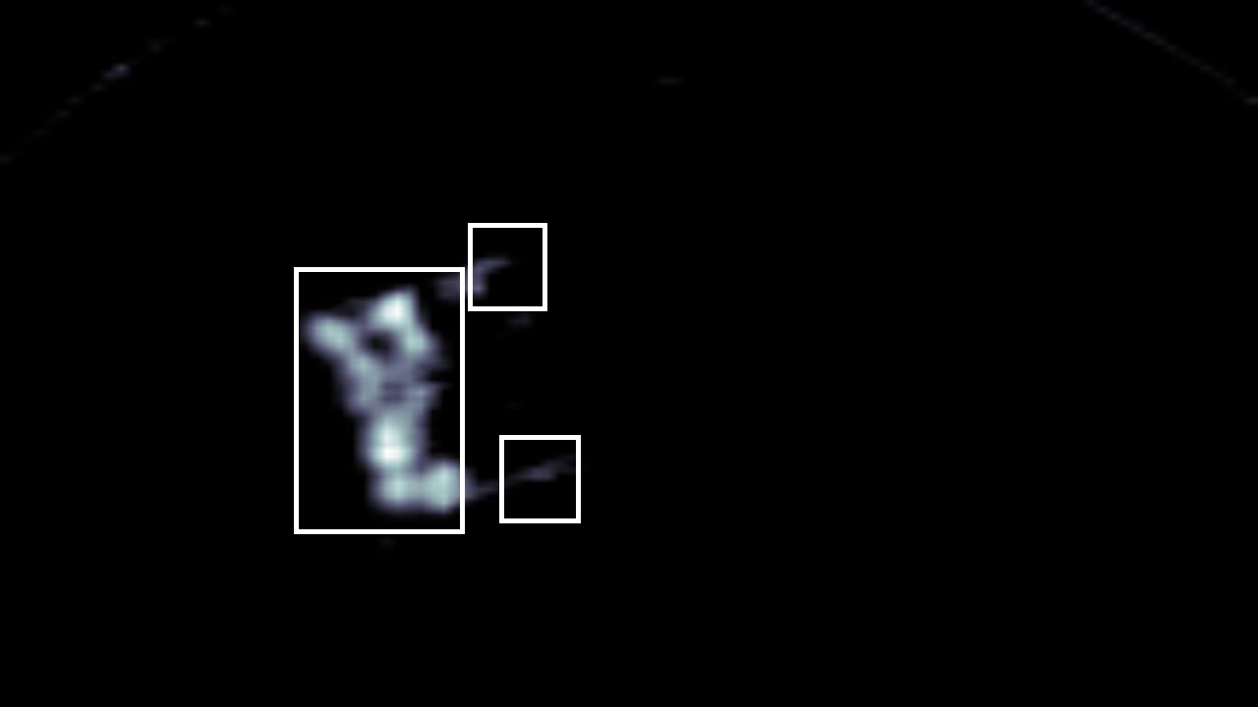
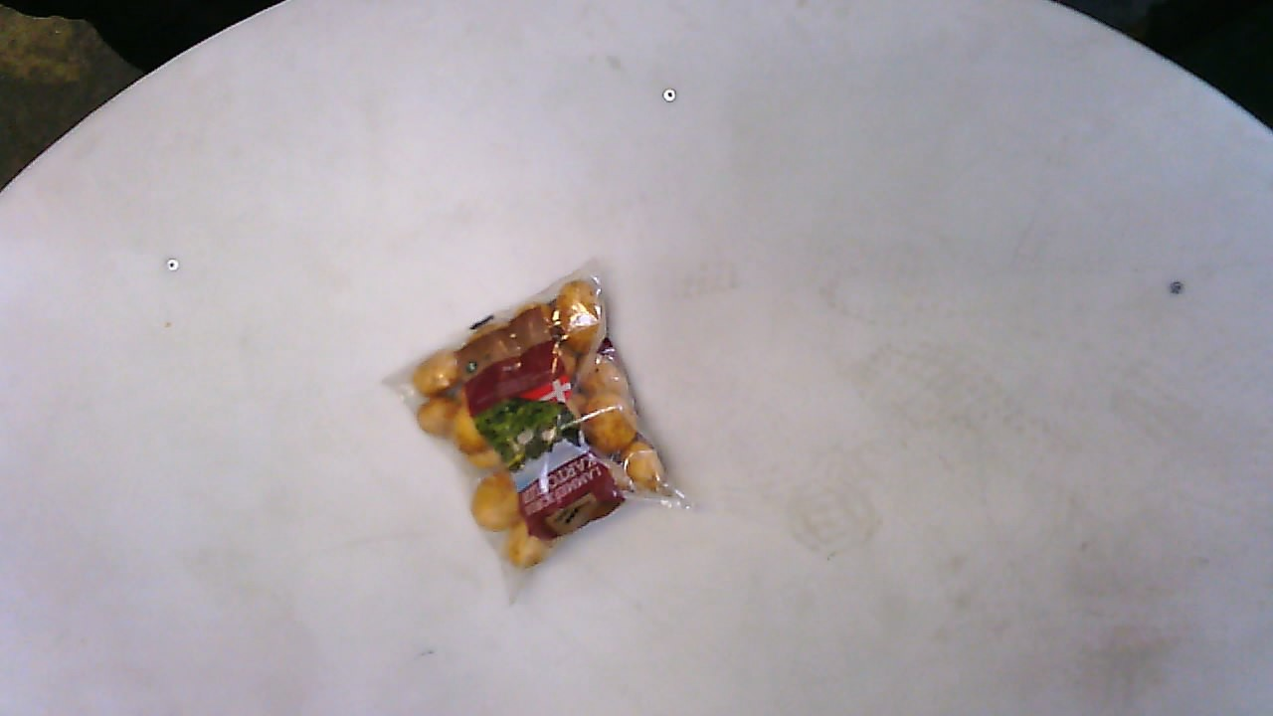
Classification loss
Bounding box
regression loss
FC layers
RoI Pooling layer
Feature
map with RoIs
CNN
Region proposal method
Input image

Slide 4
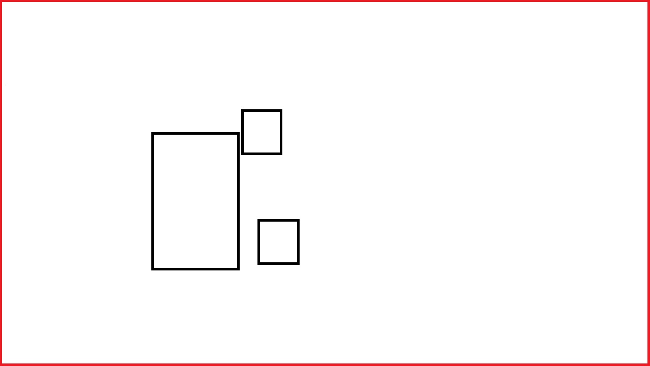

Classification loss
Bounding box
regression loss
Classification network
Classification loss
Bounding box
regression loss
RoI pooling
Proposal regions
Region proposal network
Feature map
CNN
Input image

Slide 5
Label
Bounding box
CNN
RoI
Background Subtraction
Input image

